Slide 1
Murach’s SQL Server 2022
Chapter 13
How to work
with views

Slide 2
Objectives
Applied
Given a SELECT statement, create a new view based on the statement.
Knowledge
Describe the use of views.
Name the three SQL statements you use to work with views.
Given a SELECT statement, determine whether it can be used as the basis for a view.
Given a SELECT statement, determine whether it can be used as the basis for an updatable view.
Describe the benefits provided by views.
Describe the effects of the WITH SCHEMABINDING and WITH ENCRYPTION clauses on a view.

Slide 3
Objectives (cont.)
Describe the effect of the WITH CHECK OPTION clause on an updatable view.
Describe the use of SQL Server’s catalog views for getting information from the system catalog.

Slide 4
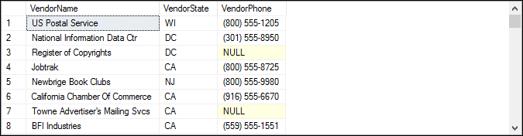
A CREATE VIEW statement
CREATE VIEW VendorsMin AS SELECT VendorName, VendorState, VendorPhone FROM Vendors;
The virtual table for the view (122 rows)

Slide 5
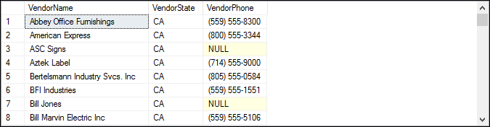
A SELECT statement that uses the view
SELECT * FROM VendorsMin WHERE VendorState = 'CA' ORDER BY VendorName;
The result set (75 rows)

Slide 6
Some of the benefits provided by views
Design independence
Data security
Flexibility
Simplified queries
Updatability

Slide 7
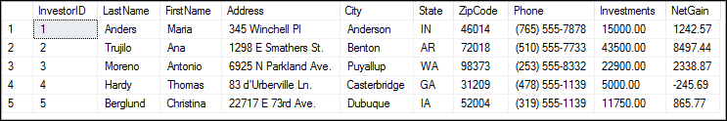
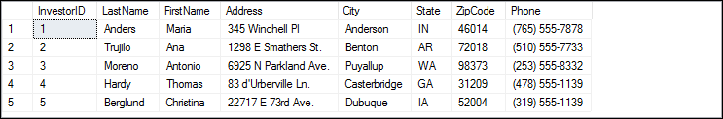
How to use a view to restrict access to data
The data in a table of investors (5 rows)
A view that restricts access to certain columns
CREATE VIEW InvestorsGeneral
AS
SELECT InvestorID, LastName, FirstName, Address,
City, State, ZipCode, Phone
FROM Investors;
The data retrieved by the view (5 rows)

Slide 8
The syntax of the CREATE VIEW statement
CREATE VIEW view_name [(column_name_1
[, column_name_2]...)]
[WITH {ENCRYPTION|SCHEMABINDING|ENCRYPTION,SCHEMABINDING}]
AS
select_statement
[WITH CHECK OPTION]

Slide 9
A view of vendors that have invoices
CREATE VIEW VendorShortList
AS
SELECT VendorName, VendorContactLName,
VendorContactFName, VendorPhone
FROM Vendors
WHERE VendorID IN (SELECT VendorID FROM Invoices);

Slide 10
A view that uses a join
CREATE VIEW VendorInvoices
AS
SELECT VendorName, InvoiceNumber, InvoiceDate,
InvoiceTotal
FROM Vendors AS v JOIN Invoices AS i
ON v.VendorID = i.VendorID;

Slide 11
A view that uses TOP and ORDER BY clauses
CREATE VIEW TopVendors
AS
SELECT TOP 5 PERCENT VendorID, InvoiceTotal
FROM Invoices
ORDER BY InvoiceTotal DESC;

Slide 12
A view that names all of its columns
CREATE VIEW OutstandingInvoices
(InvoiceNumber, InvoiceDate, InvoiceTotal, BalanceDue)
AS
SELECT InvoiceNumber, InvoiceDate, InvoiceTotal,
InvoiceTotal - PaymentTotal - CreditTotal
FROM Invoices
WHERE InvoiceTotal - PaymentTotal - CreditTotal > 0;

Slide 13
A view that names just the calculated column
CREATE VIEW OutstandingInvoices
AS
SELECT InvoiceNumber, InvoiceDate, InvoiceTotal,
InvoiceTotal - PaymentTotal - CreditTotal AS BalanceDue
FROM Invoices
WHERE InvoiceTotal - PaymentTotal - CreditTotal > 0;

Slide 14
A view that summarizes invoices by vendor
CREATE VIEW InvoiceSummary
AS
SELECT VendorName, COUNT(*) AS InvoiceQty, SUM(InvoiceTotal) AS InvoiceSum
FROM Vendors AS v JOIN Invoices AS i
ON v.VendorID = i.VendorID
GROUP BY VendorName;

Slide 15
A view that uses WITH SCHEMABINDING
CREATE VIEW VendorsDue WITH SCHEMABINDING
AS
SELECT InvoiceDate AS Date, VendorName AS Name,
VendorContactFName + ' ' + VendorContactLName AS Contact,
InvoiceNumber AS Invoice,
InvoiceTotal - PaymentTotal - CreditTotal AS BalanceDue
FROM dbo.Vendors AS v JOIN dbo.Invoices AS i
ON v.VendorID = i.VendorID
WHERE InvoiceTotal - PaymentTotal - CreditTotal > 0;

Slide 16
Requirements for creating updatable views
The select list can’t include a DISTINCT or TOP clause.
The select list can’t include an aggregate function such as SUM or AVG.
The SELECT statement can’t include a GROUP BY or HAVING clause.
The view can’t include the UNION operator.
Requirements for creating an updatable column
The column can’t be the result of a calculation.

Slide 17
An updatable view
CREATE VIEW InvoiceCredit
AS
SELECT InvoiceNumber, InvoiceDate, InvoiceTotal,
PaymentTotal, CreditTotal
FROM Invoices
WHERE InvoiceTotal - PaymentTotal - CreditTotal > 0;
An UPDATE statement that updates the view
UPDATE InvoiceCredit
SET CreditTotal = CreditTotal + 200
WHERE InvoiceTotal - PaymentTotal - CreditTotal >= 200;

Slide 18
A read-only view
CREATE VIEW StateTotals
AS
SELECT VendorState, SUM(InvoiceTotal) AS InvoiceTotal
FROM Invoices i JOIN Vendors v
ON i.VendorID = v.VendorID
GROUP BY VendorState;

Slide 19
A view with a read-only column
CREATE VIEW OutstandingInvoices
AS
SELECT InvoiceNumber, InvoiceDate, InvoiceTotal,
InvoiceTotal - PaymentTotal - CreditTotal AS BalanceDue
FROM Invoices
WHERE InvoiceTotal - PaymentTotal - CreditTotal > 0;

Slide 20
The syntax of the DROP VIEW and ALTER VIEW statements
DROP VIEW
DROP VIEW view_name
ALTER VIEW
ALTER VIEW view_name [(column_name_1 [, column_name_2]...)]
[WITH {ENCRYPTION|SCHEMABINDING|ENCRYPTION,SCHEMABINDING}]
AS
select_statement
[WITH CHECK OPTION]

Slide 21
Statements that modify and delete a view
Create the view
CREATE VIEW Vendors_SW
AS
SELECT *
FROM Vendors
WHERE VendorState IN ('CA','AZ','NM');
Modify the view
ALTER VIEW Vendors_SW
AS
SELECT *
FROM Vendors
WHERE VendorState IN ('CA','AZ','NM','NV');
Delete the view
DROP VIEW Vendors_SW;

Slide 22
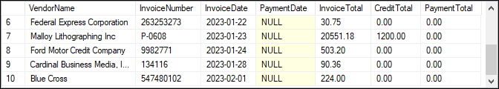
Create an updatable view that retrieves invoices with a balance due
CREATE VIEW VendorPayment
AS
SELECT VendorName, InvoiceNumber, InvoiceDate,
PaymentDate, InvoiceTotal, CreditTotal, PaymentTotal
FROM Invoices i JOIN Vendors v
ON i.VendorID = v.VendorID
WHERE InvoiceTotal - PaymentTotal - CreditTotal > 0;
The data retrieved before the update (11 rows)

Slide 23
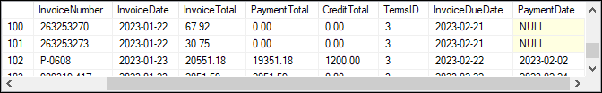
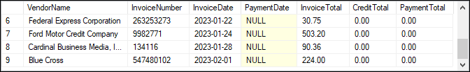
A statement that updates the Invoices table through the view
UPDATE VendorPayment
SET PaymentTotal = 19351.18, PaymentDate = '2023-02-02'
WHERE VendorName = 'Malloy Lithographing Inc' AND
InvoiceNumber = 'P-0608';
The updated Invoices table
The data retrieved after the update (10 rows)

Slide 24

Create an updatable view that retrieves the invoices for a vendor
CREATE VIEW IBM_Invoices
AS
SELECT InvoiceNumber, InvoiceDate, InvoiceTotal
FROM Invoices
WHERE VendorID = (SELECT VendorID FROM Vendors
WHERE VendorName = 'IBM');
The contents of the view

Slide 25
An INSERT statement that fails due to columns with null values
INSERT INTO IBM_Invoices (InvoiceNumber, InvoiceDate,
InvoiceTotal)
VALUES ('RA23988', '2023-03-04', 417.34);
The response from the system
Cannot insert the value NULL into column 'VendorID', table 'AP.dbo.Invoices'; column does not allow nulls. INSERT fails.

Slide 26
A DELETE statement that succeeds
DELETE FROM IBM_Invoices
WHERE InvoiceNumber = 'Q545443';
The response from the system
(1 row affected)

Slide 27
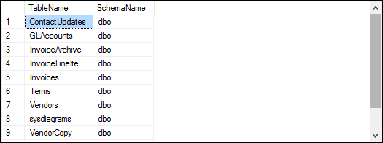
How to use the catalog views
Retrieve the name and schema of each table
SELECT t.name AS TableName, s.name AS SchemaName
FROM sys.tables t
JOIN sys.schemas s
ON t.schema_id = s.schema_id;
The result set

